Slide 1
Committee Meeting:
June 8, 2015
Jake Heare
Committee:
Steven Roberts
Bonnie J. Becker
Kerry Naish

Slide 2
Population structure and adaptation
of Ostrea lurida in Puget Sound
Jake Heare

Slide 3
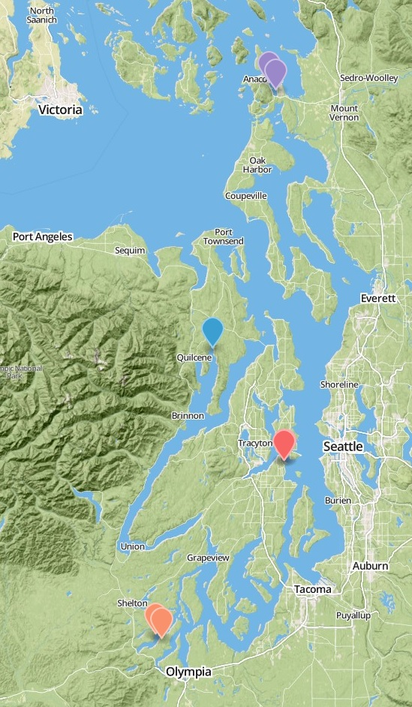
Experiment Basics
Fidalgo Bay
Reciprocal Transplant
Collected 2012
Larvae June 2013
Outplant August 2013
Monitored
3 Oyster Groups
4 Sites
1 Year
Dabob Bay
Manchester
Oyster Bay

Slide 4
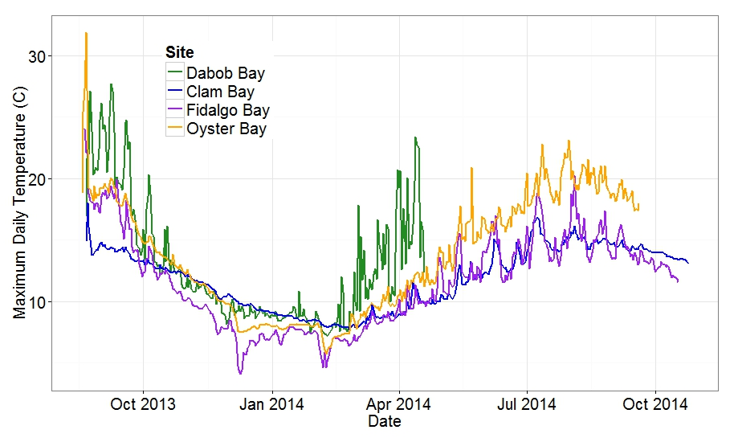
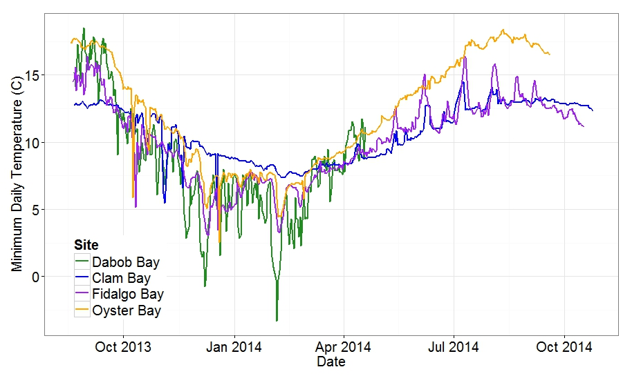
Fidalgo Bay
Dabob Bay
Manchester
Oyster Bay

Slide 5
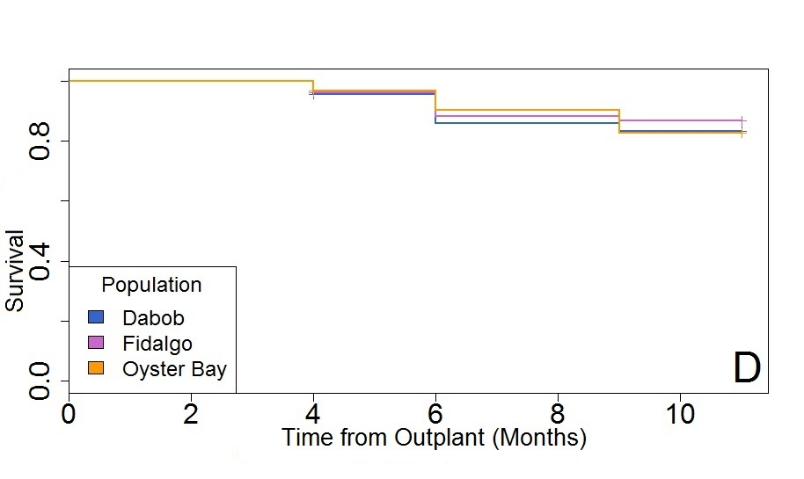
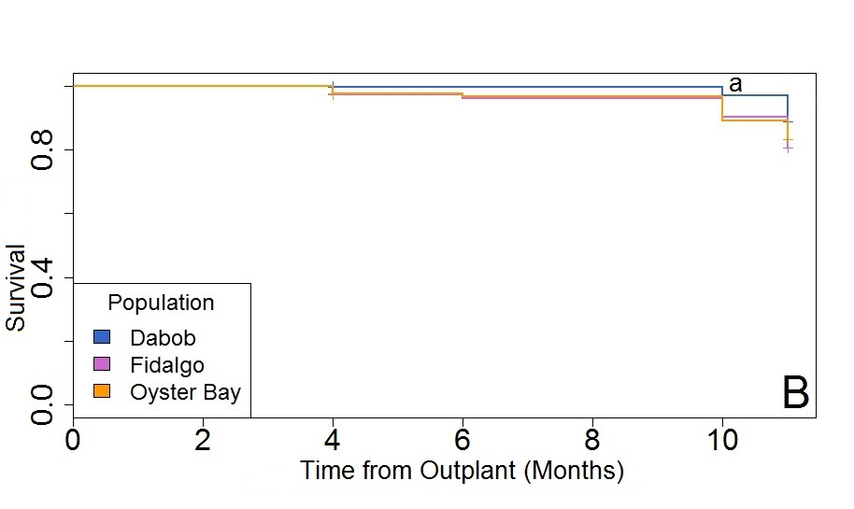
1.0
0.5
0
Fidalgo Bay
Dabob Bay
Aug Oct Dec Feb Apr June
1.0
0.5
0
Manchester
Oyster Bay
Aug Oct Dec Feb Apr June
Notes:
Make into two slides

Slide 6
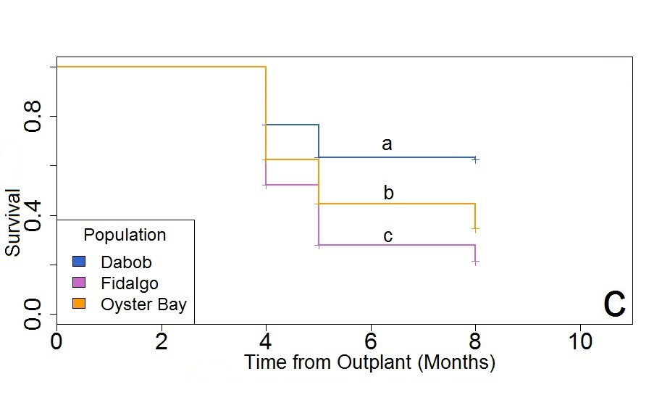
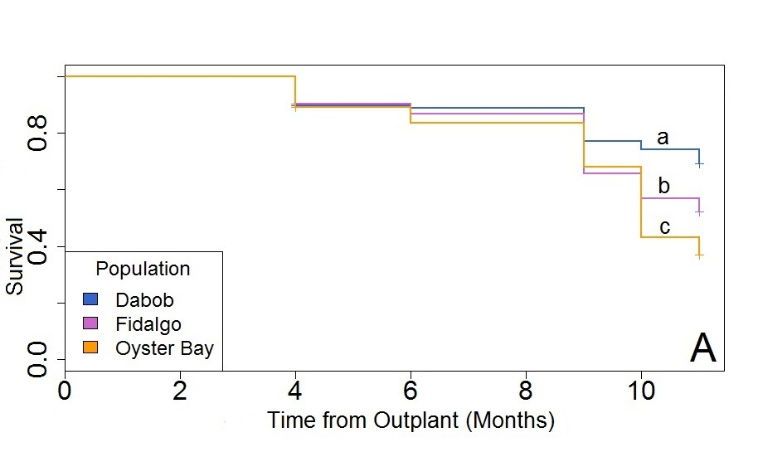
1.0
0.5
0
Fidalgo Bay
Aug Oct Dec Feb Apr
Dabob Bay
1.0
0.5
0
Manchester
Oyster Bay
Mortality
Aug Oct Dec Feb Apr June
Notes:
Make into two slides

Slide 7
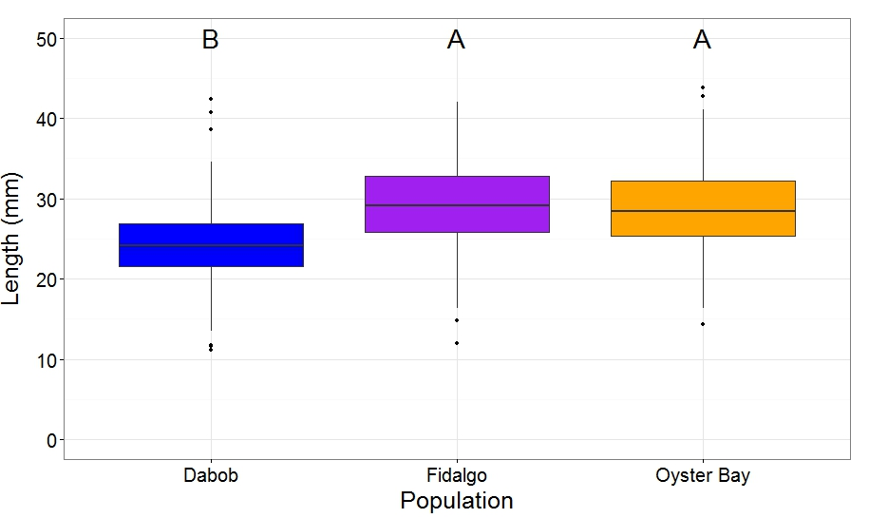
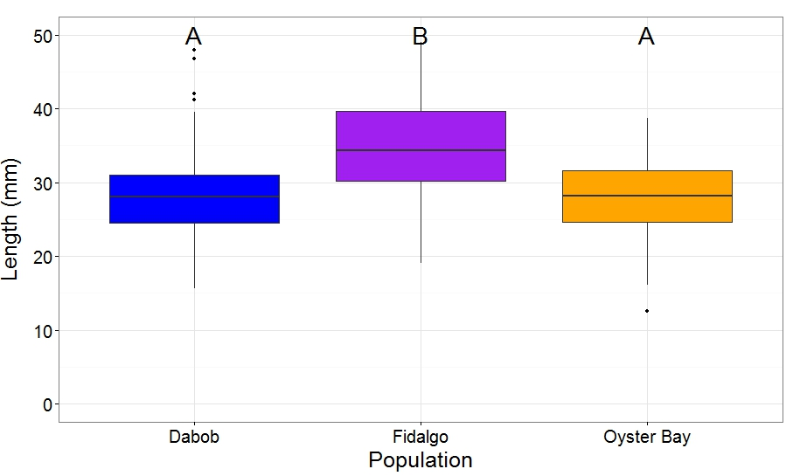
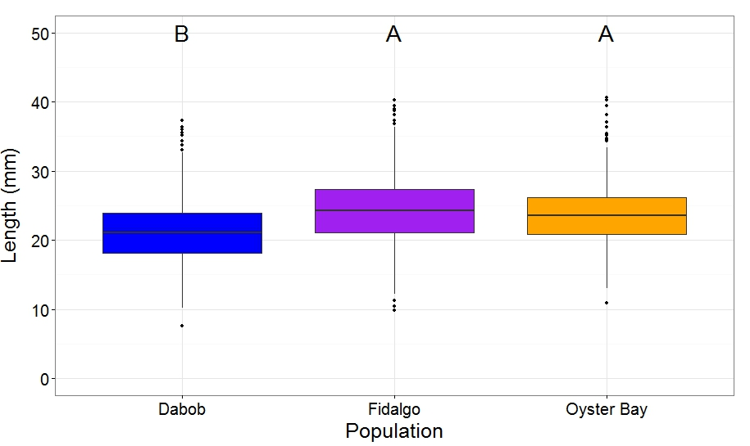
Outplanted Populations
Dabob
Group
Fidalgo
Fidalgo
Group
Oyster Bay
Group
Dabob
Dabob Bay
Manchester
Oyster Bay
Fidalgo
Dabob
Growth

Slide 8
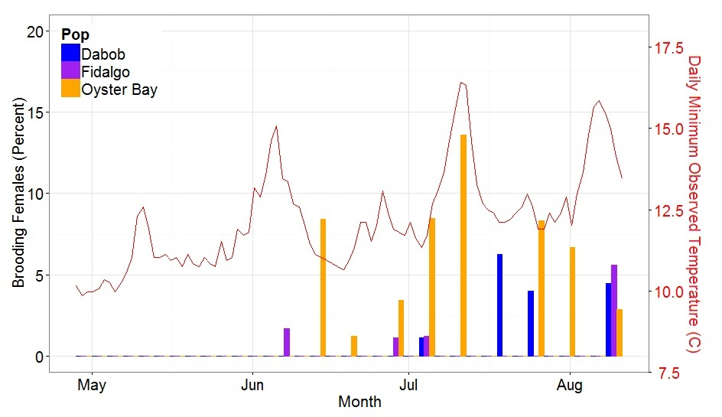
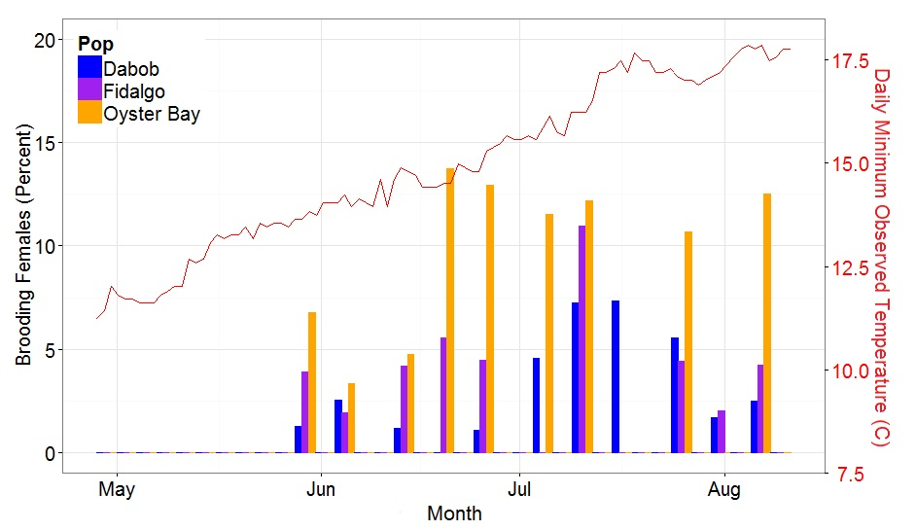
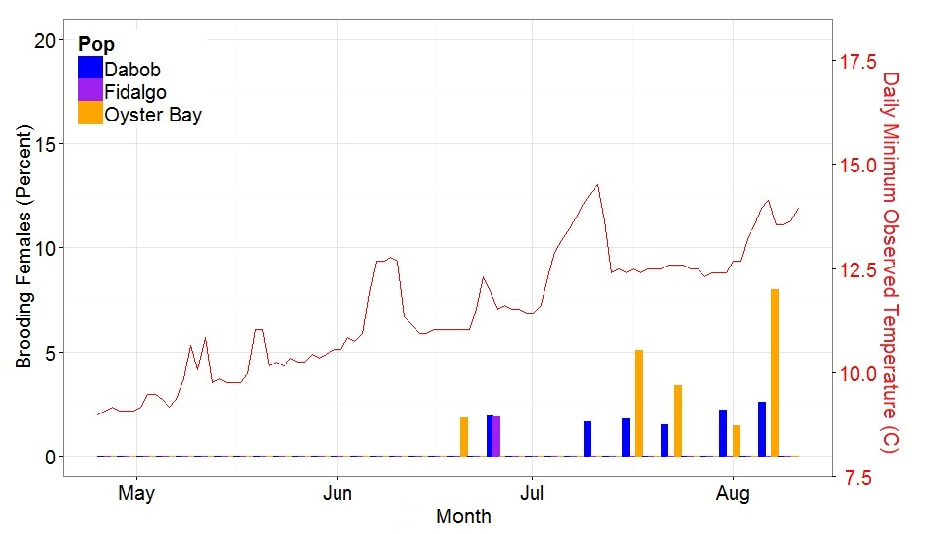
Outplanted Populations
Dabob
Group
Fidalgo
Fidalgo
Group
Oyster Bay
Group
Dabob Bay
Manchester
Oyster Bay
Reproduction

Slide 9
Summary
Mortality
Dabob Best Survival
Fidalgo High Mortality in Dabob
Growth
Dabob Smallest
Reproduction
Oyster Bay Most Active
Dabob Least Active
Dabob oysters
Exhibit high stress resilience
Tradeoffs of limited growth/reproduction
Oyster Bay oysters
Exhibit high reproductive effort
Tradeoffs of limited stress resilience
Fidalgo Bay oysters
Exhibit low stress resilience
Tradeoffs for growth/reproduction

Slide 10
Hypotheses
The Dabob population appears to be more stress resilient thus we expect:
Dabob to respond faster to stress with initial expression of stress resilience genes
To have reduced expression of genes related to energy going to growth and reproduction
The Oyster Bay and Fidalgo populations appear to be less resilient so we expect:
Slower response to stress with low initial expression but higher expression at 24 hour mark
Higher expression of growth and reproduction genes

Slide 11
Physiological differences?
Lab Experiment and Gene Expression
Animals
Collected from Manchester
Held at 8 C
Fed Daily
Weekly water changes
Thermal Stress
1 Hour
38 C
Mechanical Stress
5 minutes
1000 RPM
Sampling
1 hr post stressor
24 hr post stressor
control collected 24 hr
Mortality monitoring
Checked once daily
Two weeks
Fed Daily

Slide 12
Experiment: Mortality
Mechanical Stress
No Mortalities
Heat Stress
All populations reach zero on Day 7

Slide 13
Select Targets
Toll-like receptor 2 type-1
TNF receptor-associated factor 3 (EC 6.3.2.-)
Peptidoglycan recognition protein 1 (Peptidoglycan recognition protein short) (PGRP-S)
Histone-arginine methyltransferase CARM1 (EC 2.1.1.-)
Bone morphogenetic protein 2 (BMP-2) (Bone morphogenetic protein 2A) (BMP-2A)
Heat shock protein beta-11 (Hspb11) (Placental protein 25) (PP25)
Prostaglandin E2 receptor EP4 subtype (PGE receptor EP4 subtype)
(Gamma-aminobutyric acid type B receptor subunit 1 (GABA-B receptor 1) (GABA-B-R1) (GABA-BR1) (GABABR1) (Gb1)
Growth factor receptor-bound protein 2 (Adapter protein GRB2)
Histone H3.3
Histone H2A.V (H2A.F/Z) (Fragment)
Histone H2A
Inhibitor of growth protein 4 (p29ING4)
Heat Shock Protein 70kDa

Slide 14
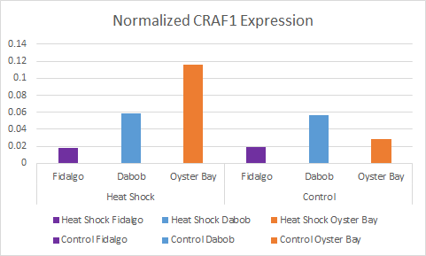
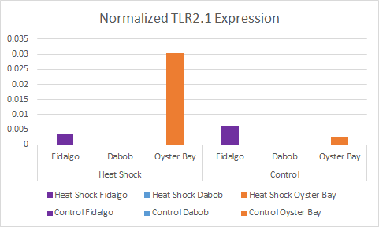
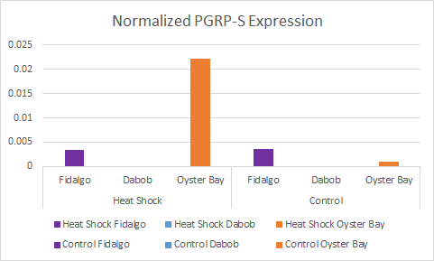
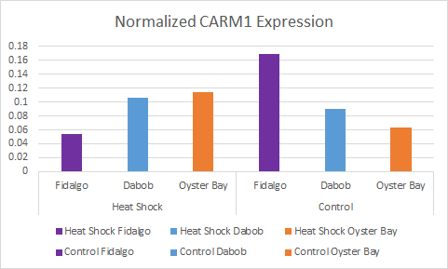
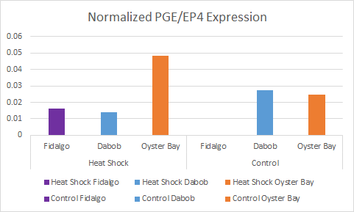
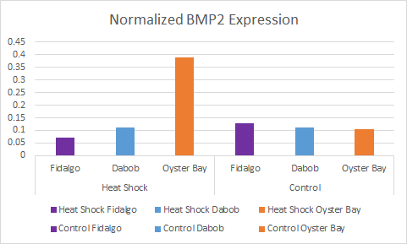
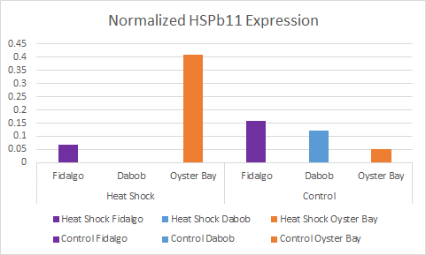
Gene
Expression

Slide 15
Timeline
June
qPCR
PCR
Analyze Results
June 22nd - 26th
Revise Chapter 1
June 9 - 12th
July
Write Chapter 2
Complete Thesis Draft
August
Draft to Committee August 1st
Defend
Aug 17th - 20th
Turn Thesis and Approval form in Aug 21

